Slide 1
LAPTOP DATASET
PROJECT WORKFLOW:
DATA UNDERSTANDING
DATA CLEANING
OUTLIERS
EDA[EXPLORATORY DATA ANALYSIS]
HARINI B
DATA ANALYST
MILESTONE – 1
31.05.2024

Slide 2
INTRODUCTION
The objective of the laptop project is to analyze a dataset containing information about Laptop.
Derive insights that can be useful for various purposes such as company, type name, or inches factors influencing property values.
The dataset contains information about various attributes of Laptop.
COMPANY: Laptop company brands.
TYPENAME: Types of ultrabook ,notebook and touchscreen.
SCREEN RESOLUTION: Screen resolution of the laptop
PRICE: Price of laptop.
OPERATING SYSTEM: consist of the OS of the system

Slide 3
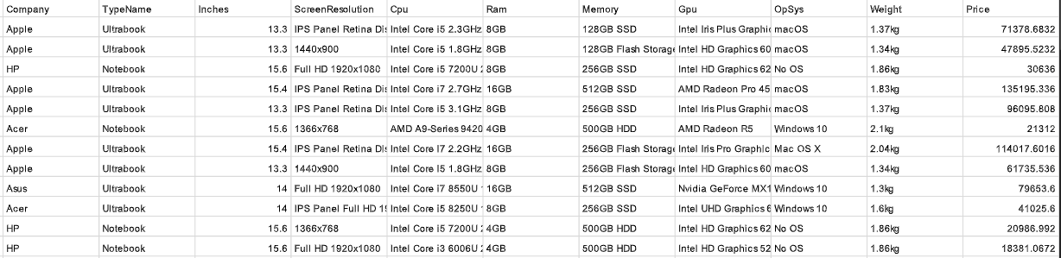

Slide 4
IMPORTANCE OF ANALYSIS
Understanding the data helps in identifying which features are important for predicting laptop prices.
Involves correlation between the float and integer.
Handling Missing values.
Dealing with Outliers.
Data Visualization (DV):
DV is needed to transform raw data into easily understandable visual representation.
Using charts, graphs and maps.

Slide 5
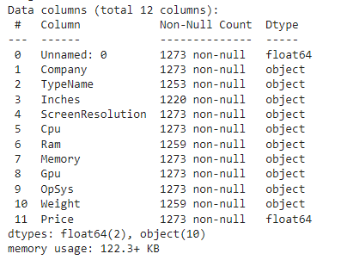

Slide 6
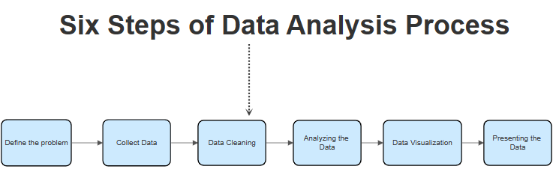
Understanding the data is a critical step in any data science project, as it lays the foundation for all subsequent methods.In the laptop data, data understanding involves examining the structure, contents, and relationship within the dataset.
Import Required Function:
import pandas as pd
import numpy as np
import matplotlib.pyplot as plt
import seaborn as sns

Slide 7
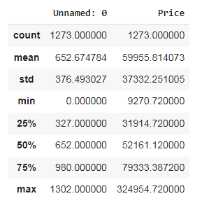
DATA UNDERSTANDING
Dataset Structure has number of rows and columns.
laptop.shape(1303,12)
Information about the dataset.laptop.info()
Summary Statistics:(For numerical features)
Mean
Median
Minimum
Maximum

Slide 8
INITIAL EXPLORATION
MISSING VALUES
OUTLIERS
DISTRIBUTIONS
CORRELATION
Based on the patterns the missing values is observed.
Identify columns with a high percentage of missing values that may need imputation or removal.
Identify the outliers using the box plots, extremely high or low values might be outliers.

Slide 9
MISSING VALUES HANDLING
TECHNIQUES USED TO DETECT MISSING VALUES.
Checking for missing values with isnull() and sum():
Use isnull() to detect missing values.
Sum the missing values for each column to get an overview.
import pandas as pd
# Load your dataset
df = pd.read_csv(laptop.csv’)
laptop.isnull().sum().sum()
#Check for missing values
missing_values = df.isnull().sum()
print(missing_values)

Slide 10
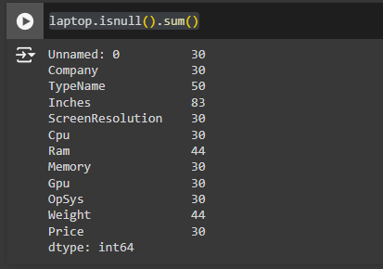
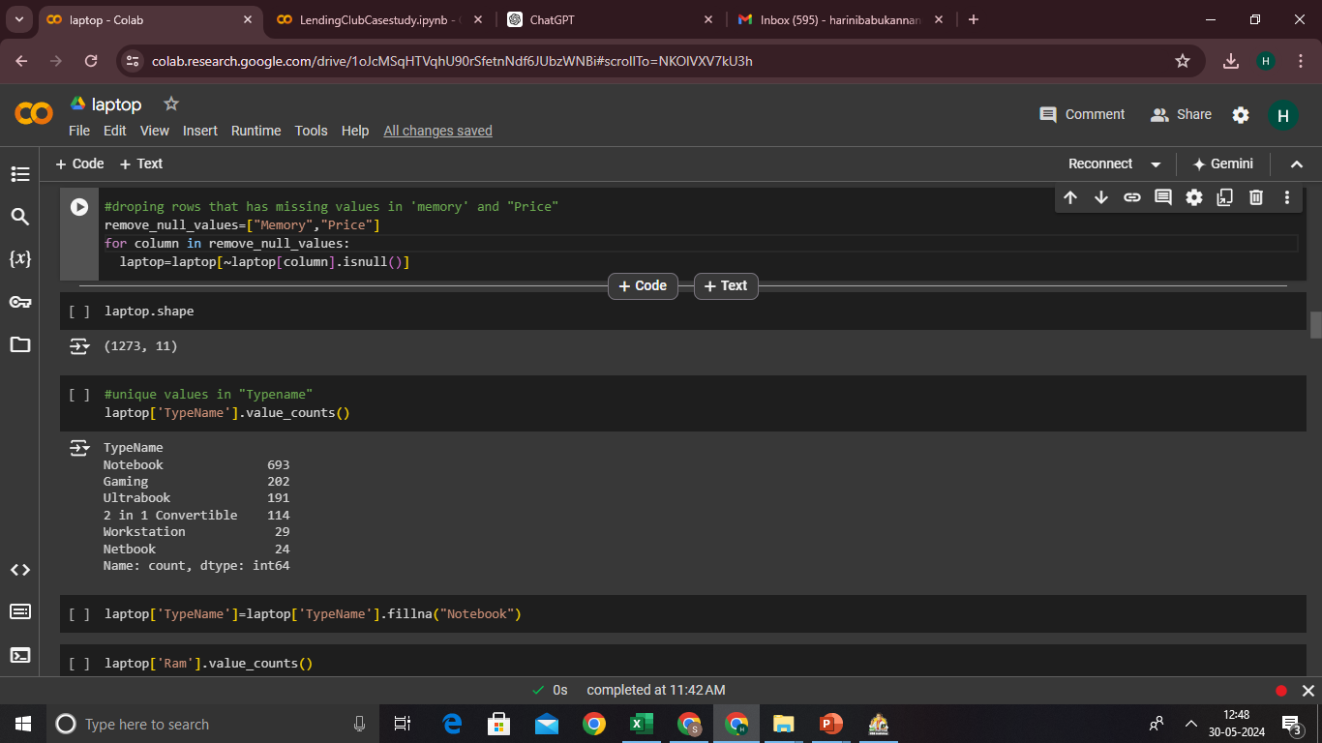
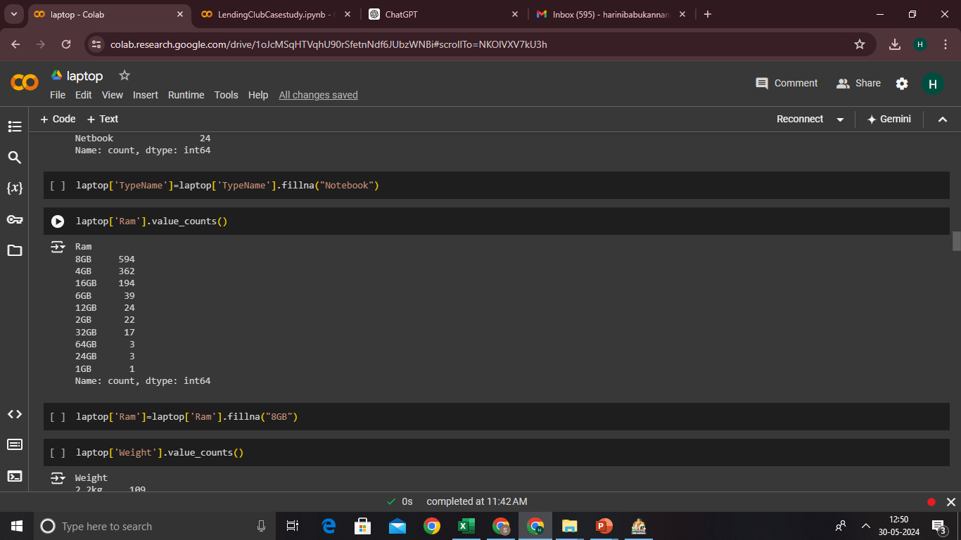
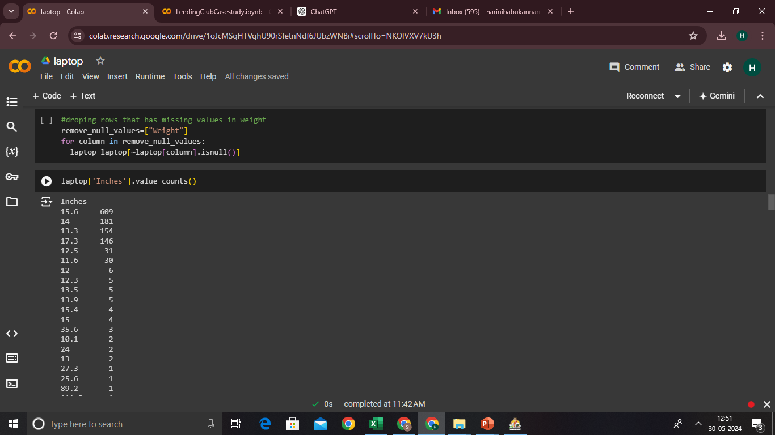
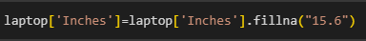

Slide 11
Shape of the dataset
Drop rows with missing values
Drop columns with missing values
SHAPE OF THE DATASET (Before Cleaning) : (1303,12)
SHAPE OF THE DATASET (After Cleaning) : (1259,11)

Slide 12
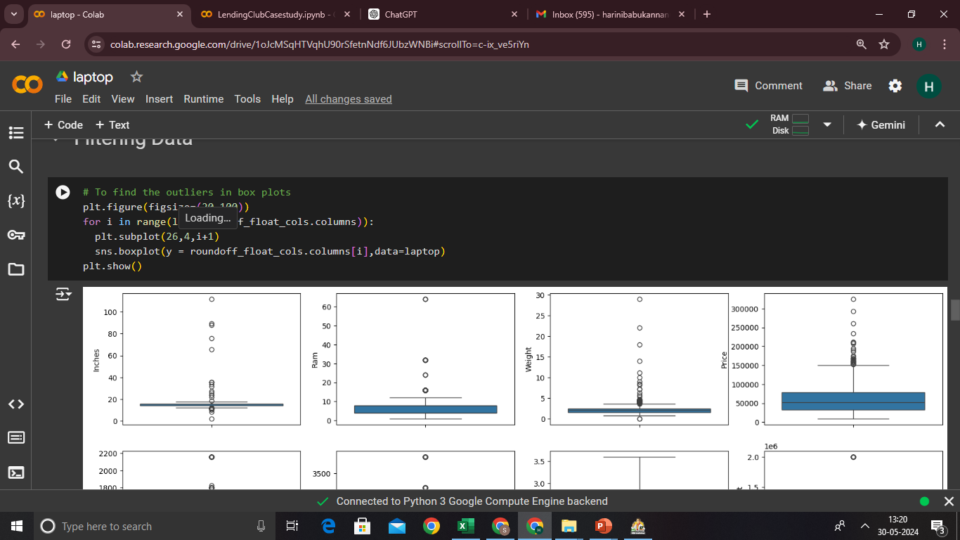
OUTLIERS HANDLING
Identifying and handling outliers is a crucial step in data processing for a laptop dataset project
Identifying outliers using IQR method

Slide 13
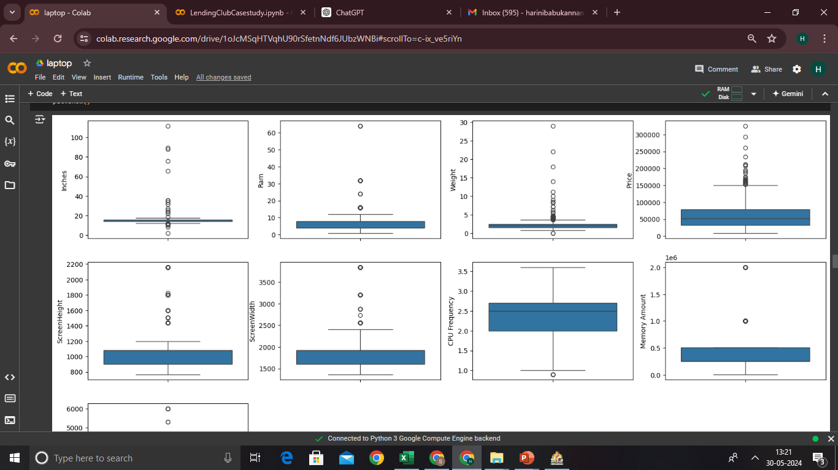

Slide 14
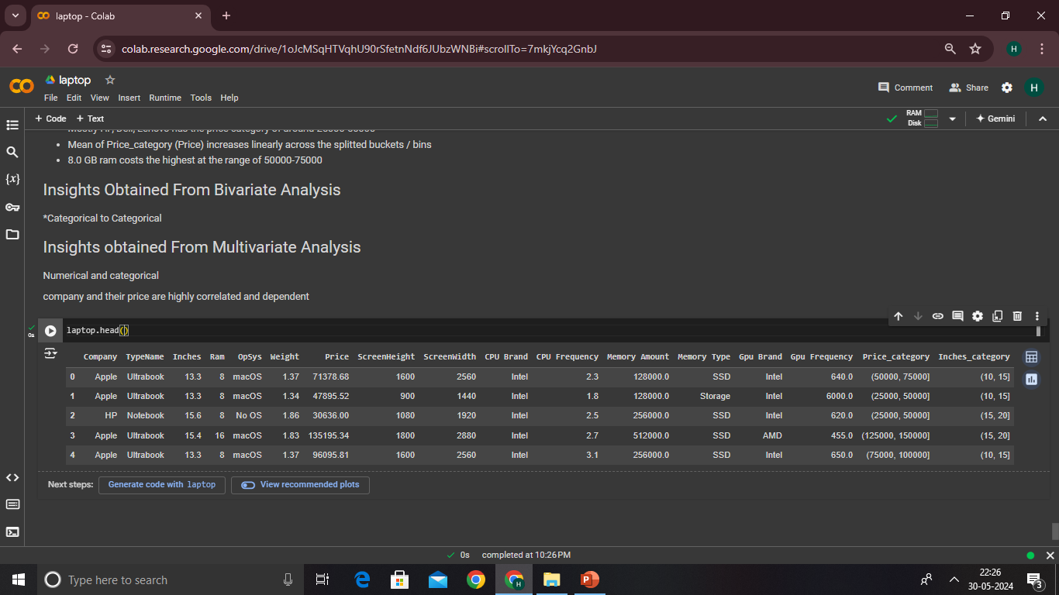
DERIVED METRICES
Derives new columns such as “screenheight”, ” memory “, ”Screenwidth”,”cpu frequency”,”gpu frequency

Slide 15
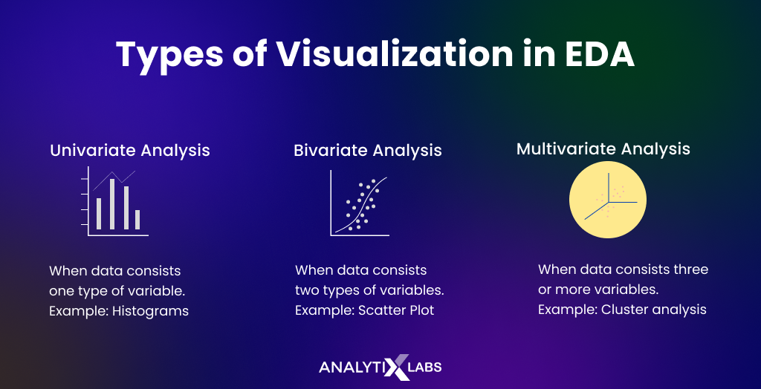
EDA

Slide 16
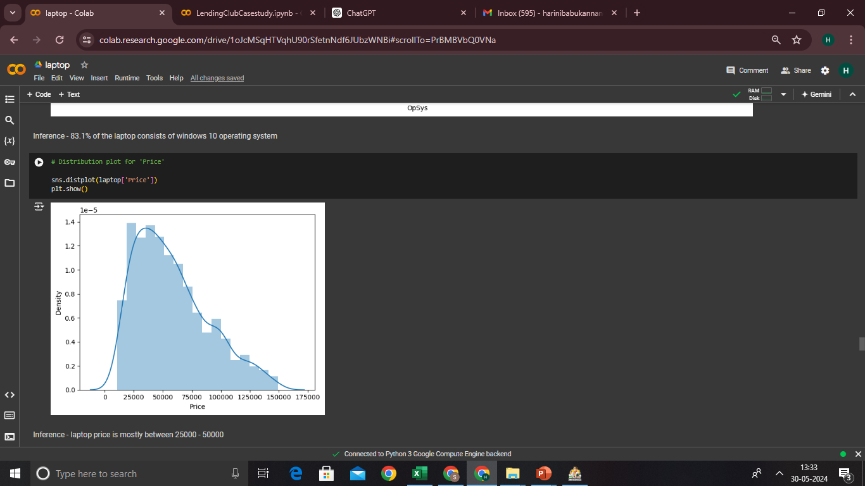
Univariate analysis

Slide 17
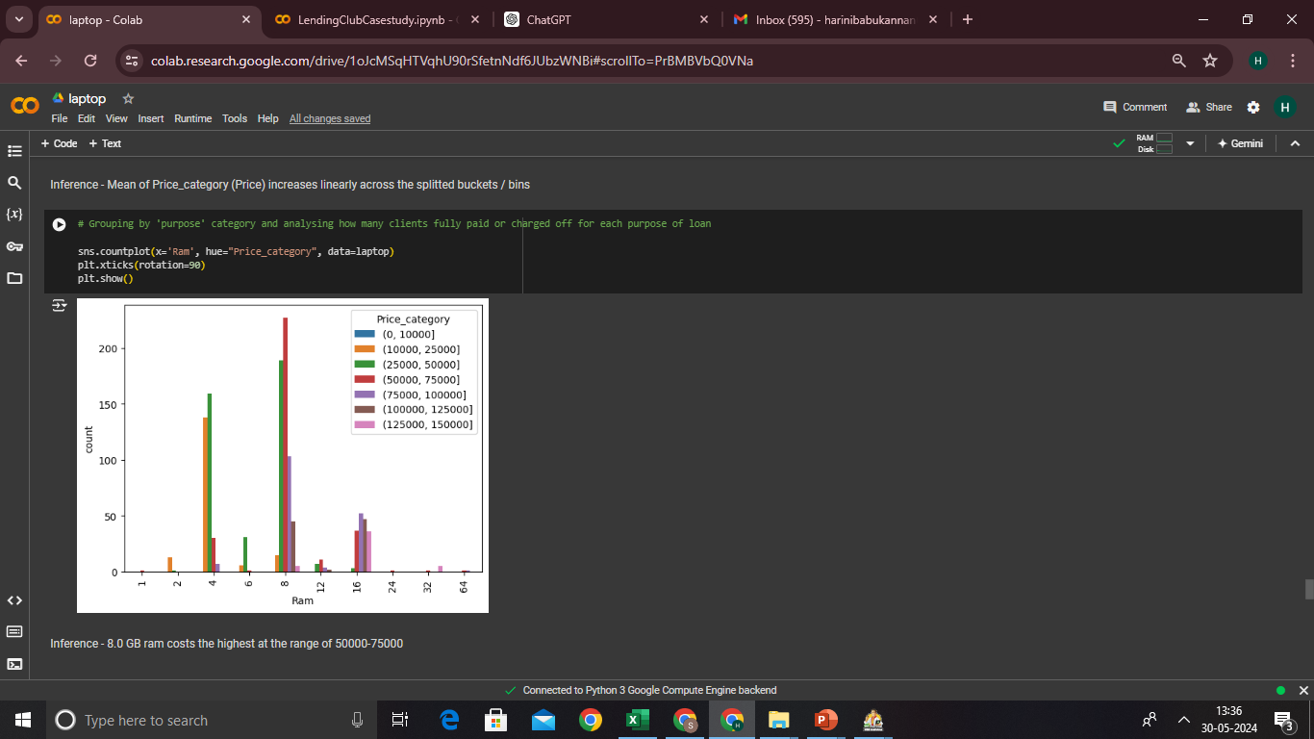
Segmented univariate analysis

Slide 18
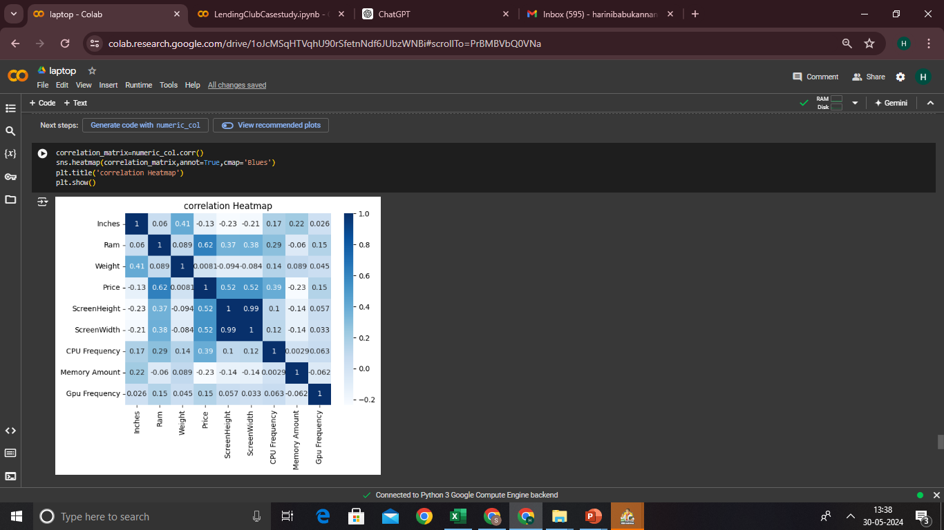
Bivariate analysis
Inference – Price and Ram are highly corelated
screenheight and screenwidth with price are slightly corelated

Slide 19
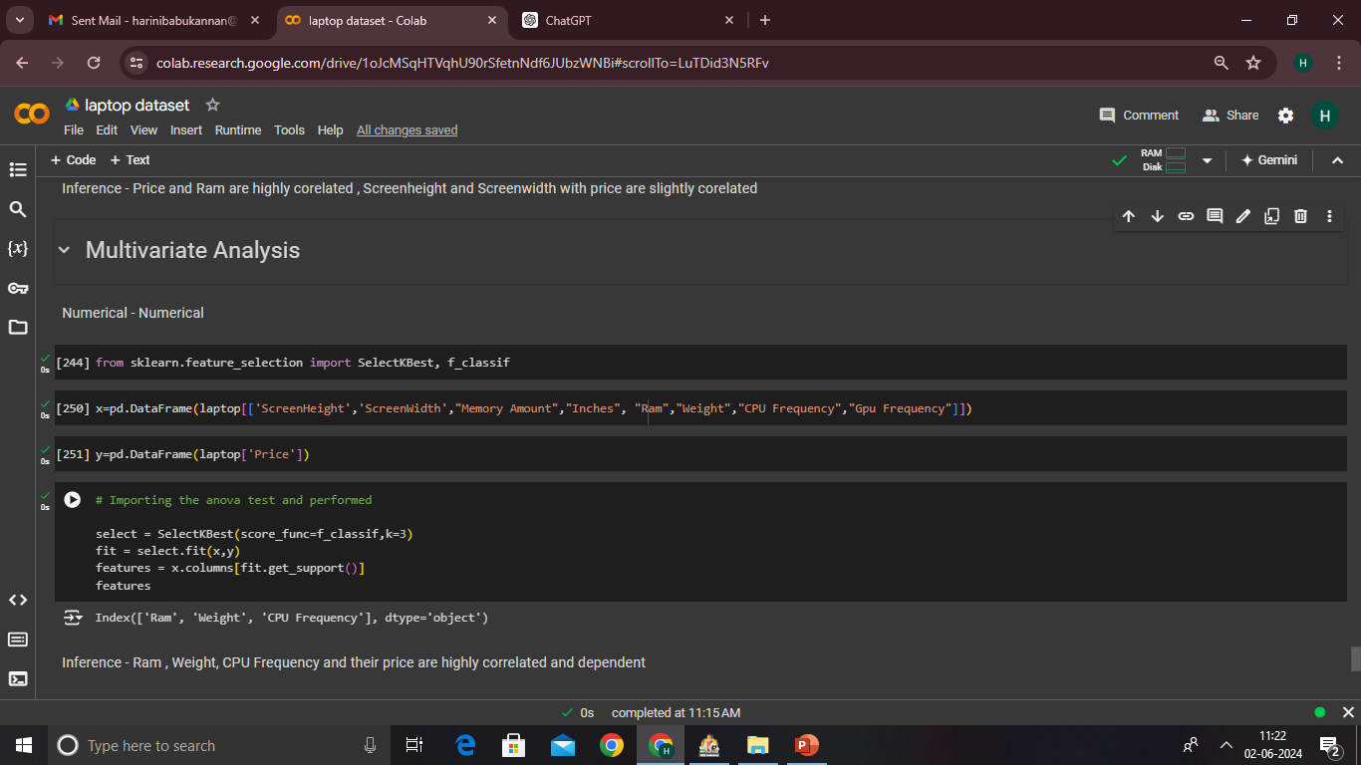
Multivariate analysis(Anova Test)

Slide 20
insights
Insights obtained from univariate analysis
Laptop price is mostly between 25000 – 50000
Insights obtained from segmented univariate analysis
8.0GB ram is mostly manufactured with the cost around 50000 – 75000
Insights obtained from bivariate analysis
Price and Ram are highly corelated
screenheight and screenwidth with price are slightly corelated.
Insights obtained from Multivariate analysis using anova test
Ram , Weight, CPU Frequency and their price are highly correalted and dependent

Slide 21
Recomendations:
Product Pricing:
Since the majority of laptop prices fall between 25000 – 50000, consider focusing on offering competitive pricing within this range. Ensure that your product lineup includes a variety of laptops with different specifications and features to cater to various consumer preferences within this price bracket.
RAM Configuration:
Given that laptops with 8.0GB RAM are associated with higher price categories (around 50000 – 75000), consider emphasizing the value proposition of higher RAM configurations in your marketing efforts. Highlight the performance benefits of 8.0GB RAM and position these laptops as premium options for consumers who prioritize performance and multitasking capabilities.
Product Differentiation:
Differentiate your product offerings based on RAM configurations, weight, CPU frequency, and other factors identified as significant predictors of price. Develop unique selling points and features that set your laptops apart from competitors and appeal to target consumers in specific market segments

